Slide 1
LANE DETECTION

Slide 2
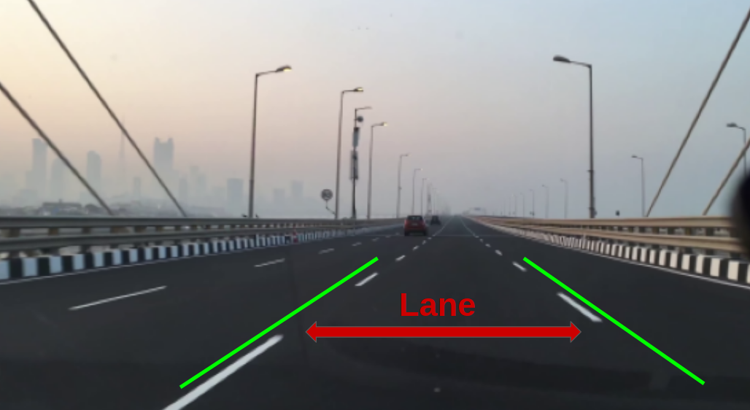
Objective
To detect lanes on a road in real time using the OpenCV computer vision library and Python.

Slide 3
Work flow
Isolate Pixels That Could Represent Lane Lines
Identify Lane Line Pixels
Overlay Lane Lines on Original Image
1
3
5
2
4
6
Apply Perspective Transformation to Get a Bird’s Eye View
Set Sliding Windows for White Pixel Detection
Calculate Lane Line Curvature,
Display Final Image

Slide 4



1. Libraries used
Computer vision is a process by which we can understand the images and videos how they are stored and how we can manipulate and retrieve data from them.
OpenCV is the huge open-source library for the computer vision, machine learning, and image processing
NumPy is the fundamental package for scientific computing in Python. It is a Python library that provides a multidimensional array object.
Matplotlib is a cross-platform, data visualization and graphical plotting library for Python and its numerical extension NumPy. As such, it offers a viable open source alternative to MATLAB.

Slide 5
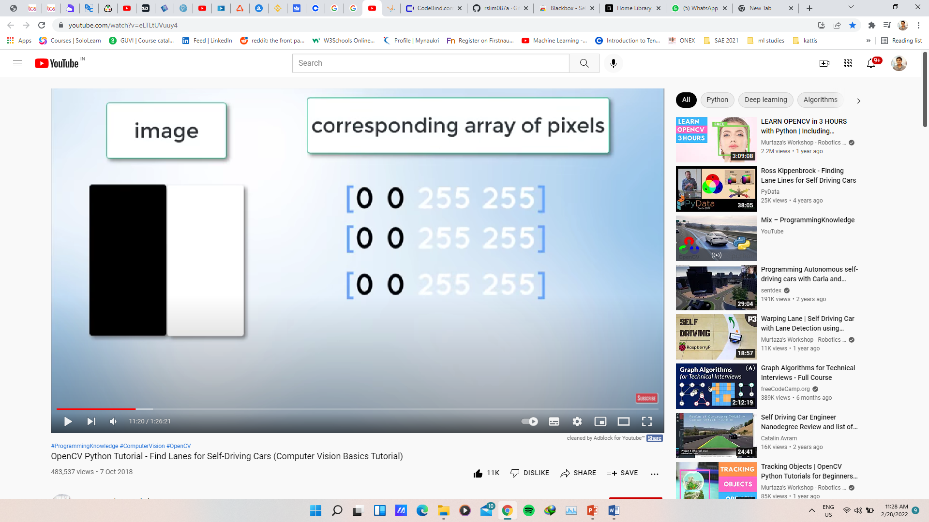
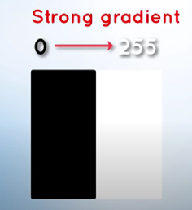
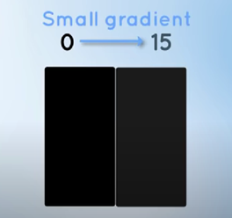
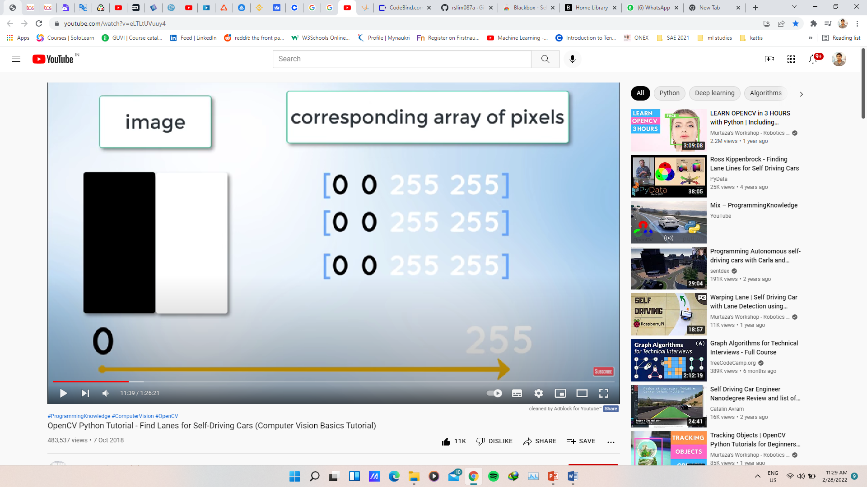
2. Intensity, Gradient of images
Gradient: Measure of change in brightness over adjacent pixels
0 - No intensity
255 - Max intensity
Steep change
Shallow change

Slide 6
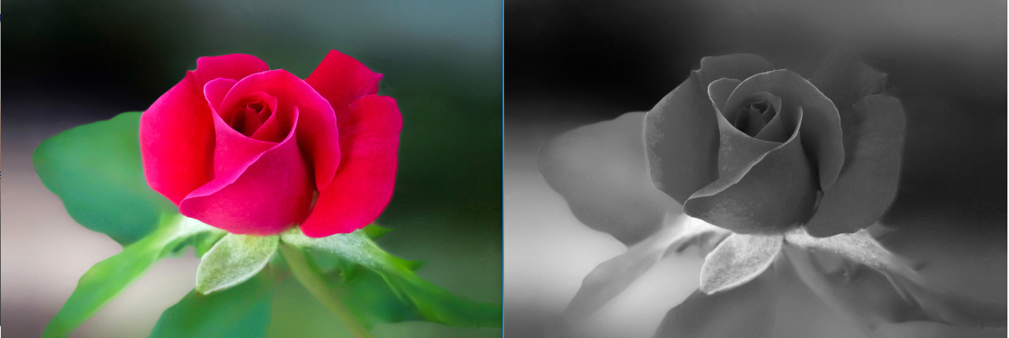
Converting image to Gray scale
As we know images are made of pixels
Each pixel is combination of 3 channel
Grayscale conversion makes normal (3 channel) image into single channel image.
Single channel simplifies the algorithm and reduces computational requirements
3channel image
(RGB)
Single channel Image
(Intensity range0-55)

Slide 7
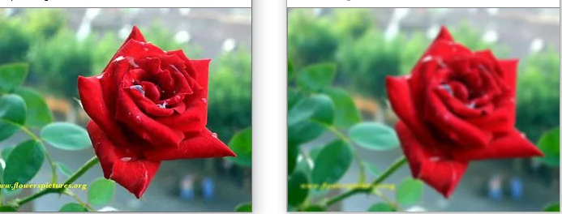
3. Gaussian blur
Reduce the Noise and smoothens the Grey scale image
Gives better clarity to the image
Without Gaussian Blur
No noise reduction
With Gaussian blur

Slide 8
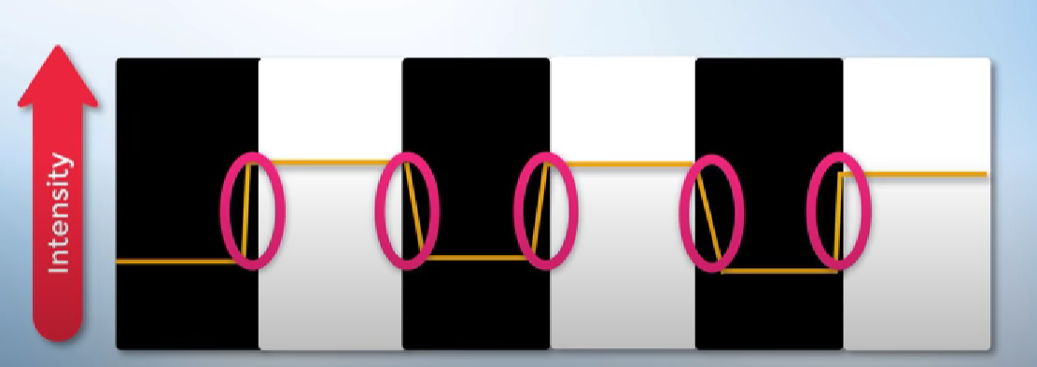
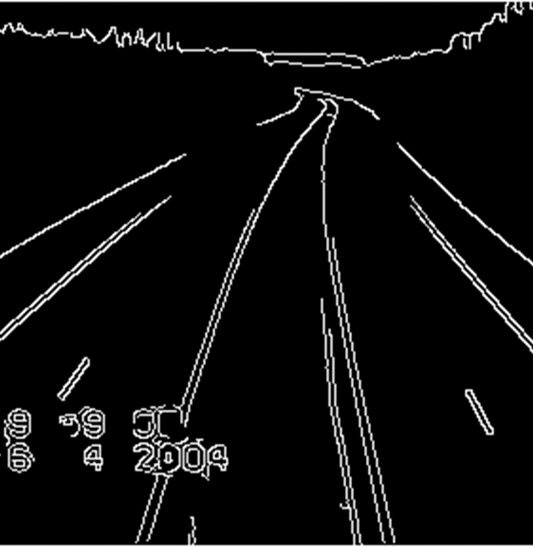
4. Canny edge detection
Edge Detection: Identifying sharp changes in intensity in adjacent pixels
Canny Edge Detection: Finding out the strongest gradient and by it we can detect the edge in the image.

Slide 9
Thresholding
It is a technique in OpenCV, which is the assignment of pixel values in relation to the threshold value provided.
Lower Threshold(50) : If the gradient is lower then the lower threshold then it will be rejected.
Higher Threshold(150) : If the gradient is higher then the upper threshold then it will considered as edge.

Slide 10
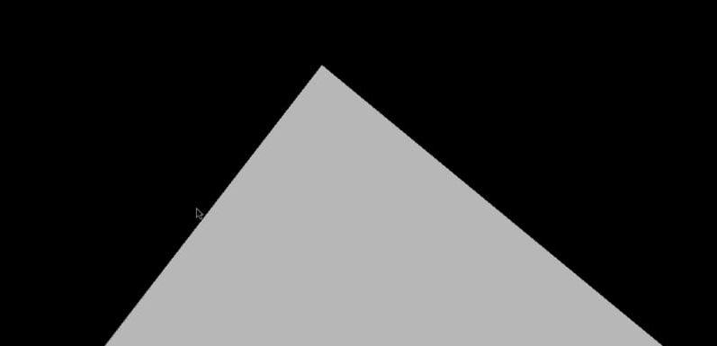
5. Region of interest
By using the matplotlib we specify a Triangular polygon by using the height of the image.

Slide 11
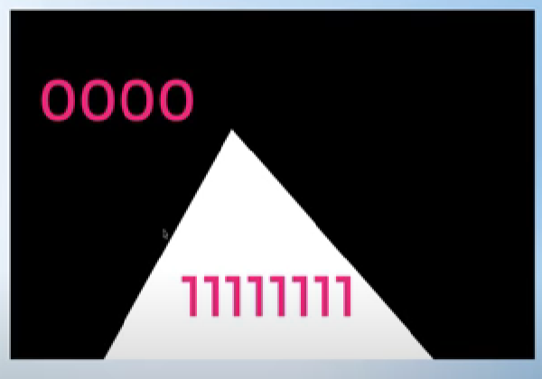
6. Using bitwise & and combining images
A= 1 1 1 1 1 1 1 1 1
B= 0 0 0 0 1 1 1 1
If we use And operator for A and B the output will be 0 0 0 0 1 1 1 1
And it is same for the image also

Slide 12
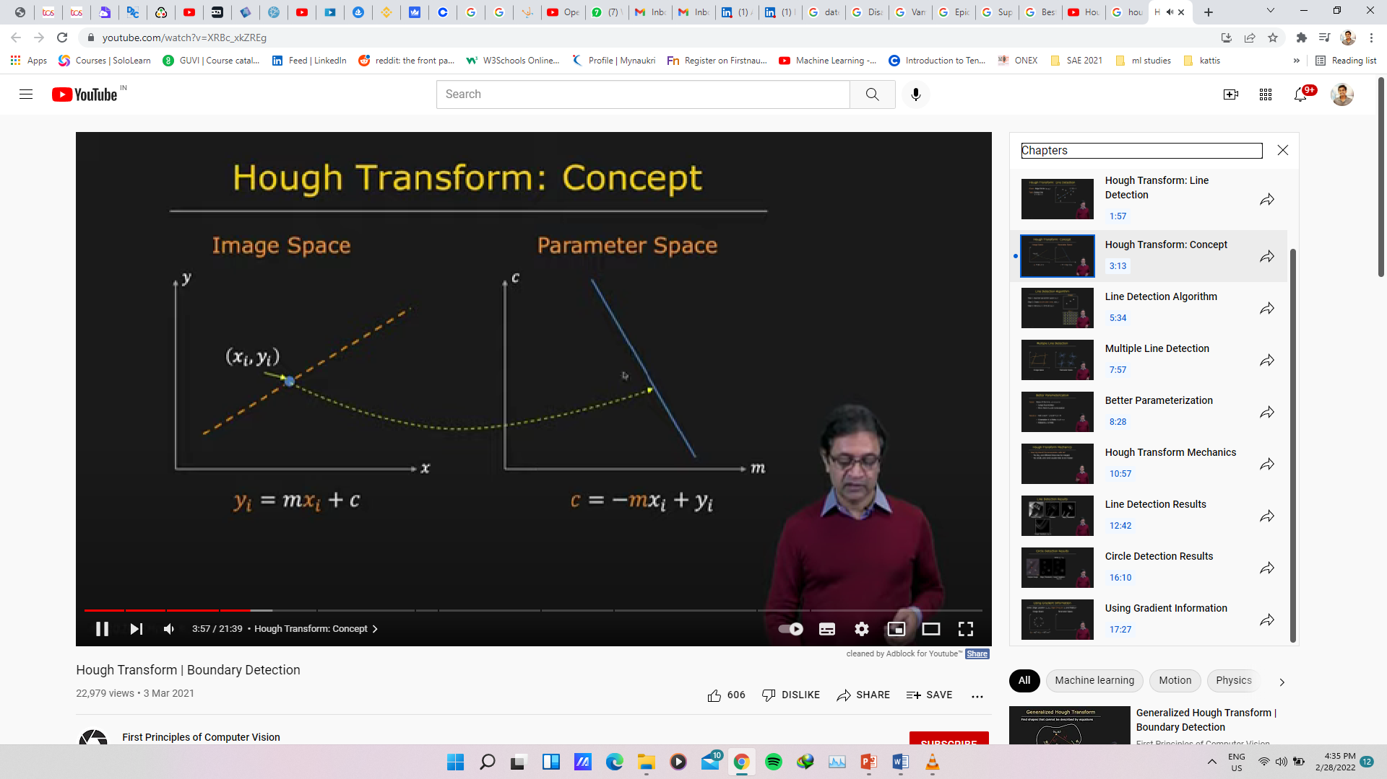
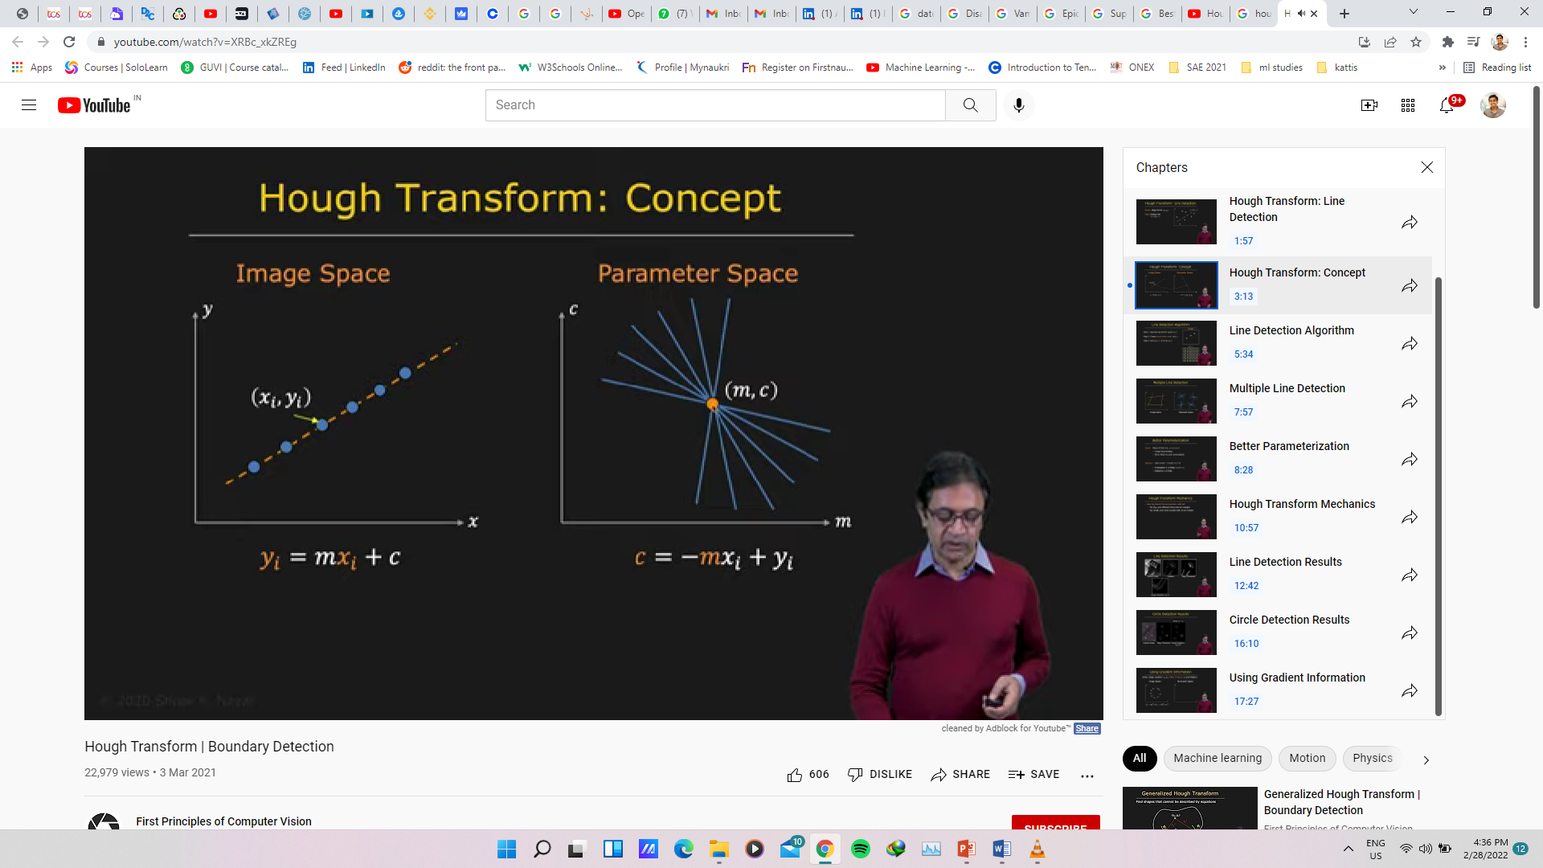
7. Hough Transform
m - Slope
b - Intercept
Parameter Space or Hough Space

Slide 13
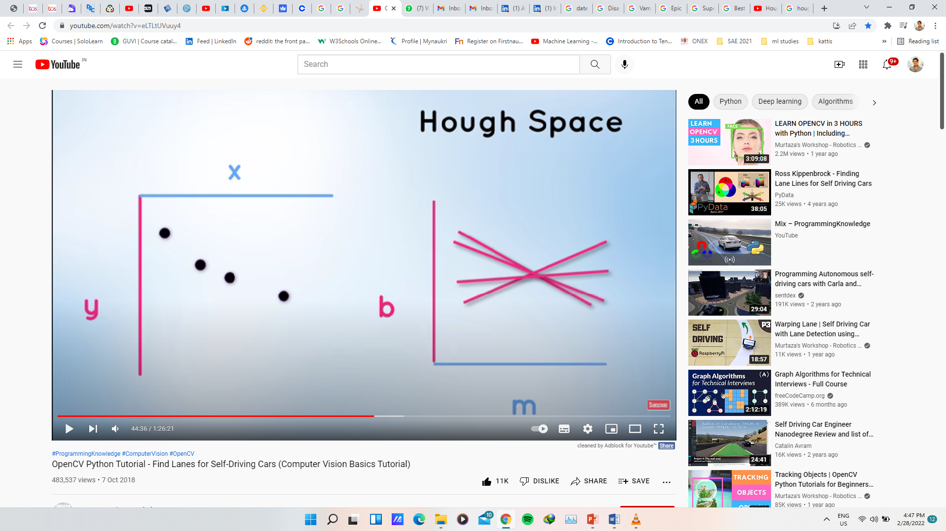
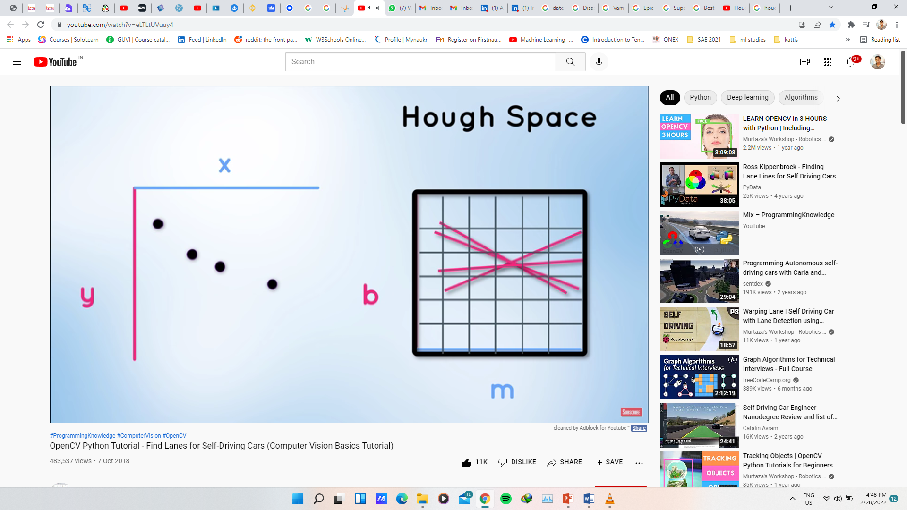
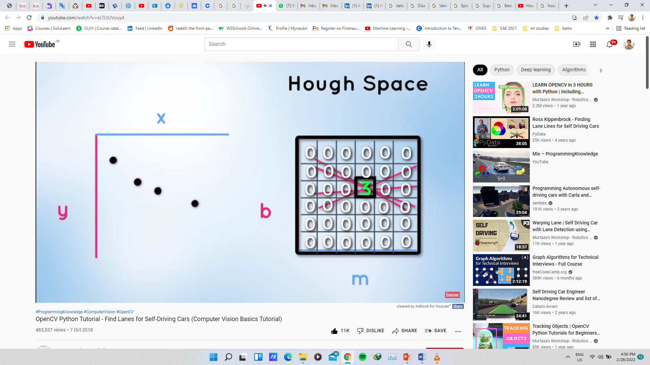
Hough space and Line of best fit
Point of Intersection/ Line of Best Fit

Slide 14
Thank You

